Slide 1

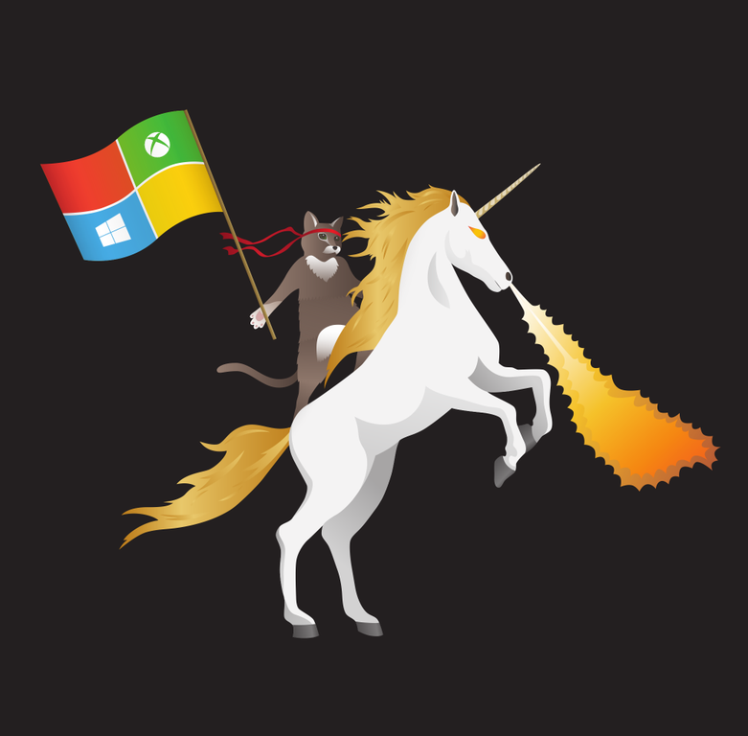
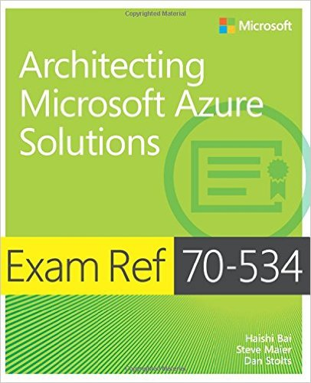



DevOps Containers and Next Generation Micro Services 101
Slides: https://github.com/dstolts/Resource
Search DevOps
Dan Stolts (@ITProGuru) Chief Technology Strategist US DX North East – Audience Blog: ITProGuru.com
dstolts@Microsoft.com
www.linkedin.com/in/danstolts
aka.ms/70-534-book
Specializations:
Cloud, Virtualization, Windows Server
@ITProGuru
Notes:
Title: DevOps, Containers and Next Generation Micro Services
Abstract: Are you up to speed with the next HUGE WAVE of virtualization… containers and micro services? How will these great technologies impact our datacenters as they move into the mainstream? Come to this session to have a look at the near future. On this journey, we will explore what and why of micro services and containers, how these new virtualization technologies will change our world and at what pace. We will show off some great new technologies built into Windows Server 2016 and get an understanding on how these new technologies will RAPIDLY change not only the virtualization landscape but also the cloud landscape.
Name of Presenter: Dan Stolts
Bio of Presenter (max 500 spaces): Dan Stolts “ITProGuru” is a technology expert who is a master of systems management and security. He is Chief Technology Strategist for Microsoft, owns several businesses and is a published author. Reach him on his primary blog http://itproguru.com or twitter @ITProGuru. He is proficient in many datacenter technologies (Windows Server, System Center, Virtualization, Cloud, Etc) and holds many certifications including MCT, MCITP, MCSE, TS, etc. Dan is currently specializing in system management, virtualization and cloud technologies. Dan is and has been a very active member of the user group community. Dan is an enthusiastic advocate of technology and is passionate about helping others. See more at: http://itproguru.com/about

Slide 2
Join US – Microsoft Developer Meetups
New York Pluralsight Study Group: www.meetup.com/NYPluralsightStudy
6-19-17: Understanding ASP.NET Core Security Week 2 of 3
6-26-17: Understanding ASP.NET Core Security Week 3 of 3
Microsoft Makers & App Devs New Jersey: www.meetup.com/MMADNJ
6-20-17: Breaking in Bots with Node.js with Rachel White
NYC Mobile .NET Developers Group: www.meetup.com/nycmobiledev
6-20-17: Designing Mobile Driven IoT Architecture
7-18-17: Build 2017 Recap for Xamarin Developers
8-15-17: Multi-Targeting the World: A Single Project to Rule Them All
Microsoft Makers & App Devs New York: www.meetup.com/MMADNYC
6-27-17: Breaking in Bots with Node.js with Rachel White
New York ALT.NET Software Development Group: www.meetup.com/nycmobiledev
6-28-17: Decomposing a monolith into Microservices with the Open Web Interface for .NET

Slide 3
DevOps Containers and Next Generation Micro Services 101
Title: DevOps, Containers and Next Generation Micro Services
Abstract: Are you up to speed with the next HUGE WAVE of virtualization… containers and micro services? How will these great technologies impact our datacenters as they move into the mainstream? Come to this session to have a look at the near future. On this journey, we will explore what and why of micro services and containers, how these new virtualization technologies will change our world and at what pace. We will show off some great new technologies built into Windows Server 2016 and get an understanding on how these new technologies will RAPIDLY change not only the virtualization landscape but also the cloud landscape.
Name of Presenter: Dan Stolts (@ITProGuru; https://linkedin.com/in/danstolts)
Bio of Presenter (max 500 spaces): Dan Stolts “ITProGuru” is a technology expert who is a master of systems management and security. He is Chief Technology Strategist for Microsoft, owns several businesses and is a published author. Reach him on his primary blog http://itproguru.com or twitter @ITProGuru. He is proficient in many datacenter technologies (Windows Server, System Center, Virtualization, Cloud, Etc) and holds many certifications including MCT, MCITP, MCSE, TS, etc. Dan is currently specializing in system management, virtualization and cloud technologies. Dan is and has been a very active member of the user group community. Dan is an enthusiastic advocate of technology and is passionate about helping others. See more at: http://itproguru.com/about

Slide 4
Windows Server 2016, Containers and Next Generation Micro Services
Are you up to speed with the next HUGE WAVE of virtualization… containers and micro services? How will these great technologies impact our datacenters as they move into the mainstream with the soon to be released Windows Server 2016? Come to this session to have a look at the near future as well as the soon to be released tools to help us meet the demands of our businesses. On this journey, we will explore what and why of micro services and containers, how these new virtualization technologies will change our world and at what pace. We will show off some great new technologies built into Windows Server 2016 and get an understanding on how these new technologies will RAPIDLY change not only the virtualization landscape but also the cloud landscape.
Notes:
Name of Presenter: Dan Stolts
Bio of Presenter (max 500 spaces): Dan Stolts “ITProGuru” is a technology expert who is a master of systems management and security. He is Chief Technology Strategist for Microsoft, owns several businesses and is a published author. Reach him on his primary blog http://itproguru.com or twitter @ITProGuru. He is proficient in many datacenter technologies (Windows Server, System Center, Virtualization, Cloud, Etc) and holds many certifications including MCT, MCITP, MCSE, TS, etc. Dan is currently specializing in system management, virtualization and cloud technologies. Dan is and has been a very active member of the user group community. Dan is an enthusiastic advocate of technology and is passionate about helping others. See more at: http://itproguru.com/about

Slide 5
Hands On Lab Containers and Windows Server 2016
In this lab, you will gain fundamental knowledge for managing Windows Server containers on Windows 10 by using Docker commands. You will learn how to:
1.Install the pre-requisites for Docker on Windows 10.
2.Install Docker.
3.Install a Nano Server base image that is used to create containers.
4.Create containers with and without Hyper-V isolation.
5.Create layered container images from containers.
6.Remove Windows Server containers and Windows Server container images by using Docker.
You will also learn about the parent-child relationship between containers and between container images. Finally, you will learn how to deploy a Nano Server package and install the Web server role in a container.
https://labondemand.com/Launch/40A59076

Slide 6
Datacenter inflection points
Containers - DevOps
Services – IaaS, PaaS, SaaS
Infrastructure hosting – early cloud
Machine Virtualization
Physical Machines

Slide 7
Kickstart Your DevOps Journey
Introductory Meeting [1.5 hours]
Quick review of pipeline: Feedback.. Production -> Planning/Ideation. This review will help us answer the following:
Identify primary tools, processes and perceived weaknesses if any
Define needed participants/roles to be included in VSM (and hack) - includes name, email address, tittle, role (Homework?).
Schedule VSM (Aug 31-Sept 1) & Hack October ????
If time, identify any training desired
VSM – Day 1-2
Around the room intro’s
Short DevOps Training
Whiteboard Value Stream Map
Working Lunch
Plan hack priority - {if needed}
Define Success
Identify expected outcomes
Homework – if needed
Lock hack dates
Training (Docker, VSTS, Azure, Hybrid, whatever) if needed and time permits
Hackfest
Day 1 - Setup Teams; Identify requirements, Identify scribe; Perform Training; Hack rest of day 😊
Day 2- Hack all day ☺ 3pm Team scrums
Day 3-? Hack all day ☺
Last Day
Morning Test process; tweak as needed
Document – outline will be provided; Teams can use to share their success with their leadership
Working Lunch
Afternoon Document; Create follow-up plan (future hacks, deploy in production, work on different part of pipeline, etc)
2:30-3:30pm; 10-15 mins team presentations to all hackers and Q&A from other hack teams
Provide Feedback using Event Feedback URL
Plan Project Phase II
Define Post hack Schedule
Leadership team discussions of projects and priorities
Plan continued hack schedule
4:30pm hack ends

Slide 8
Who Should/Must Attend/Participate
* Management / Sr. Management Sponsor
Architects
Business Analyst
DevOps Teams
Innovation Teams
Developers
Infrastructure
Networking
Security
DBA
QA
Release Management
Management
DevOps is for senior architects, developers and engineers as well as the Innovation and DevOps teams & leadership.
- Everyone enjoys the benefits
OR Else??

Slide 9
The right discussions with the right people Getting Started
Champion? (CIO, COO, Dev Manager, Innovations Manager, DevOps Manager, Director of IT, Other?
Discussion depends on Role
Objective: Fill a fundamental Need
Start with broad advantages
Significantly reduce cost of Application build and deployment
Shorten Development cycle by months
Increase Customer Satisfaction
Get cross functional teams working together
Increase technical staff skills
Ask probing questions
What are some of the biggest challenges you and your organization are facing now?
Drill down into the answers to find how DevOps helps solve those challenges

Slide 10
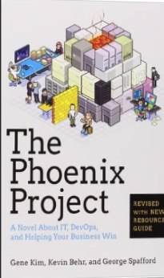
Tip: Must Read Book
Amazon…
The Phoenix Project: A Novel about IT, DevOps, and Helping Your Business Win Paperback
– October 16, 2014
The book is available on Audio Book; you can likely get it for free, if you do not already have an account. If you do not have an Audible Account, you get two free books when signing up for your free account.
This is the BEST IT Book I have ever read.

Slide 11
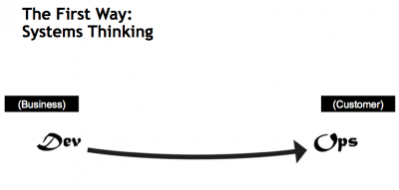
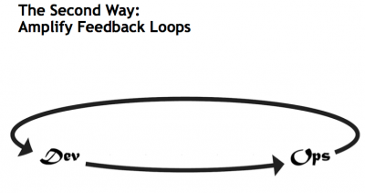
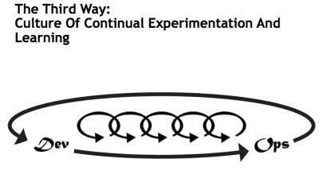
What is DevOps…
Infrastructure as Code (IaC)
Continuous Integration (CI)
Automated Testing
Application Performance Monitoring/Management (APM)
Continuous Deployment (CD)
Release Management
Configuration Management
DevOps Fundamentals
Advanced Monitoring
Capacity Management
Feature Flags
Self-Service Environments
Automated Recovery (Rollback & Roll-Forward)
Hypothesis Driven Development
Testing in Production – partial user base
Fault Injection
Usage Monitoring/Telemetry
A/B Testing (aka canary testing)
Gene Kim’s “3 ways”
The First Way emphasizes the performance of the entire system, as opposed to the performance of a specific silo of work or department — this as can be as large a division (e.g., Development or IT Operations) or as small as an individual contributor (e.g., a developer, system administrator).
The Second Way is about creating the right to left feedback loops. The goal of almost any process improvement initiative is to shorten and amplify feedback loops so necessary corrections can be continually made
The Third Way is about creating a culture that fosters two things: continual experimentation, taking risks and learning from failure; and understanding that repetition and practice is the prerequisite to mastery.
http://www.itproguy.com/devops-practices/
http://itrevolution.com/the-three-ways-principles-underpinning-devops/

Slide 12






DevOps is the union of people, process, and tools to enable continuous delivery of value of our end uses.
DEV
OPS
1
People
2
Process
3
Tools
Shared Mission: Deliver a great product that inspires our customers to become raving fans
Notes:
People = Culture
Fundamental attributes of successful cultures:
Shared mission and incentives: infrastructure as code, apps as services, DevOps/all as teams
You need to consider your hardware as a commodity, (don't give your servers names) , servers are like farm animals, it is just harder if you let theids name them
Build deep instrumentation into services, push complexity up the stack
Rally around agile, shared metrics, CI, service owners on call, etc.
Changing the culture: any change takes time, changing culture is no exception and you can't do it alone, exploit compelling events to change culture: downtimes, cloud adoption, devops buzz
PROCESS Definition and design, compliance, and continuous improvement
PEOPLE Responsibilities, management, skills development, and discipline
Tools and infrastructure

Slide 13
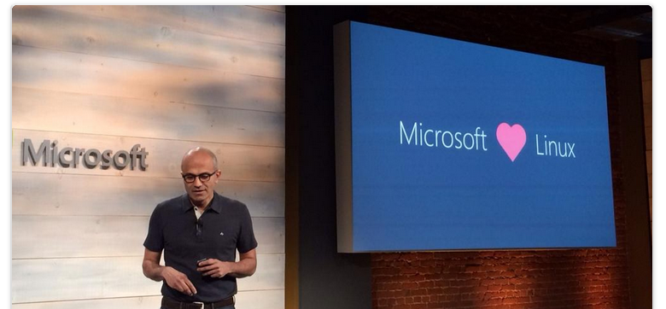
Do you know Microsoft? Cultural and Digital Transformation
#1 Contributor on GitHub?
Microsoft
Open Source:
Power BI, PowerShell, Visual Studio Code… 1732 More
Notes:
Why Azure – we have undergone massive culture change, resulting in a great environment, openness and double stock price (since Feb 2014). Microsoft is now sharing these lesson with our customers. Azure is an open cloud so whatever tools you use now, you can continue to use.

Slide 14
DevOps Practices
Primary
Secondary
Infrastructure as Code (IaC)
Continuous Integration
Automated Testing
Continuous Deployment
Release Management
App Performance Monitoring
Load Testing & Auto-Scale
Availability Monitoring
Change/Configuration Management
Feature Flags
Automated Environment De-Provisioning
Self Service Environments
Automated Recovery (Rollback & Roll-Forward)
Hypothesis Driven Development
Testing in Production
Fault Injection
Usage Monitoring/User Telemetry
http://www.itproguy.com/devops-practices/

Slide 15
Role of Security in DevOps aka DevSecOps
Incorporate security necessities into every aspect of the business; enable others to automate compliance
Making the business case:
GOVERNANCE
Security
Culture, politics, processes & laws that determine how a company should conduct itself.
Confidentiality
TRUST
Availability
Effect if uncertainty on organizational objectives.
Act of adhering & demonstrating adherence to laws, regulations, corporate policies & procedures.
Integrity
Privacy
COMPLIANCE
RISK
Help build a product that will inspire our customers to become raving fans

Slide 16
Roles and Responsibilities
Security - Incorporate security necessities into every aspect of the business; enable others to automate compliance
Development – Quickly build, deploy & update a product that our customers love; Enable other groups by building what they need to support you.
IS/IT – Build infrastructure as code; enable others by helping to eliminate waste throughout the technology landscape
Management – Enable the teams by giving them flexibility, guidance and support to do what is needed; remove obstacles
Senior Management – Embrace Cultural Change; Drive Transformation in the organization.
Everyone – Help build a product that will inspire our customers to become raving fans
Notes:
Security - Help find a way to incorporate security necessities into every aspect of the business; without getting in the way unnecessarily

Slide 17
Traditional vs modern dev-ops
Category | Traditional | Modern DevOps
Quality of code check-ins | Unknown | Validated through unit tests
Environment Creation/Configuration | Manual | Automated
Deployment Frequency | 1-2 months (or less frequent) | Deploy whenever needed, including several per day
App Deployment Process | Requires meetings and planning | Push-button deployment
Deployment validation | Manual | Automated
Monitoring | Minimal to none | Health and Performance monitoring
Dev and Ops relationship | Blame culture | Culture of trust

Slide 18
Tools: Containerization
ARM Template
2 Hosts
4 Instances of Container A
2 Instances of Container B
Container are… a technology that ENABLES and ACCELERATES DevOps
Abstract the unit of work from the VM
Lightweight, fast provisioning, density
Simplify application updates
Works with cluster managers for auto-scale capabilities
Container Host - 1
Container Host - 2
Container
A
Container
A
Container
A
Container
A
Container
B
Container
B
Orchestration Engine

Slide 19
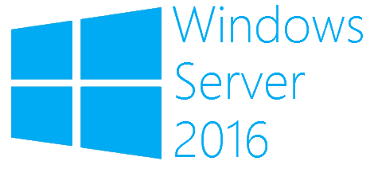
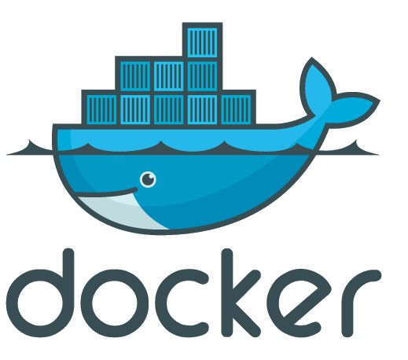
What is a container?
Containers
Windows Server containers Maximum speed and density
= Operating system virtualization
OS
Container
Container
Container
Applications
Container
Container
Container
Kernel
OS
Hardware
Kernel
Traditional virtual machines = hardware virtualization
Hyper-V containers Isolation plus performance
Application
VM
VM
VM
Container
Container
Container
OS
Hardware
Kernel
Kernel
Kernel
Hyper-V

Slide 20
What is a container?
Package distribution mechanism
MyApp.v2
MyApp.v2
Laptop/Dev Image Here
Azure Container Registry
Push
Pull

Slide 21
What is a container?
A clear boundary for your stuff
Operating
System
Web Server
Monitoring Agent
Log Roller
SSH Daemon

Slide 22
What is a container?
A clear boundary for your stuff
Operating
System
Web Server
Log Roller
SSH Daemon
Monitoring Agent

Slide 23
What is a container?
Runtime isolation
Production Web Server
Intern’s Minecraft Server

Slide 24








Architecture… Session VS VM (or VDI)
OS, Apps, Config, Mgmt
EACH Workload
Single OS
All Workloads
OS
OS
OS
OS
Apps
Apps
Apps
Apps
Massive VM Overhead
(Disk, Disk IO, Memory, CPU, OS, Licenses, Density, The works)
OS
OS
OS
OS
Apps
Apps
Apps
Apps
OS
OS
OS
OS
workloads
Apps
Apps
Apps
Apps
OS
OS
OS
OS
Apps
Apps
Apps
Apps
Application(s)
Application(s)
Operating
System
Operating
System
Parent OS
Hardware Virtualization
Hardware Virtualization
Hardware / Hypervisor Level
Session Based Computing
VM or VDI Based Computing

Slide 25
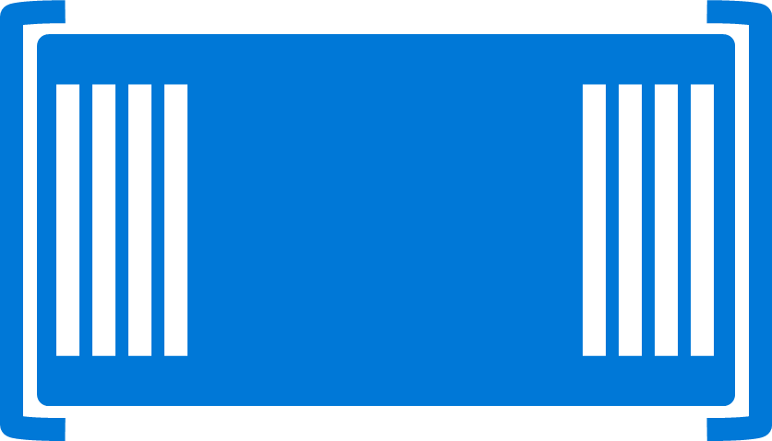

Architecture… Containers with VM isolation
OS
EACH Platform
Single OS
All Workloads
App
App
App
App
App
App
App
App
App
App
App
App
App
App
App
App
App
App
App
App
App
App
App
App
All Advantages of VM & Session
Isolation, Little overhead
workloads
App
App
App
App
App
App
App
App
Container / Image
App
App
App
App
Container Engine
App
App
Linux VM
Container / Image
Container
Container
Application(s)
Container Engine
Container Engine
Operating
System
Operating
System
Parent OS
Hardware Virtualization
Hardware Virtualization
Hardware / Hypervisor Level
Container Based Density Advantages
Container Based Computing VM Isolation

Slide 26
Architecture Deep Dive: Architecture of a Container Host
App
App
App
App
App
App
App
App
App
App
Copy on Write
Any layer that is SAVED or Downloaded is locked
Any workload
New Blank is created to allow write
Container Engine
Engine and Orchestration are different jobs, not always different products
Any workload can be set as a BASE by saving
It can then be used as a base, All required pieces below it will automatically be deployed
App
App
App
App
App
Web Sites
Web Site
Web App
App
App
Container Orchestration
Web Engine Config
IIS Config
Web Engine Config
Web Engine Base (IIS installed)
OS Base (eg. Nano)
Container Engine (Windows, Linux, Docker)
Operating
System
Hardware Virtualization

Slide 27
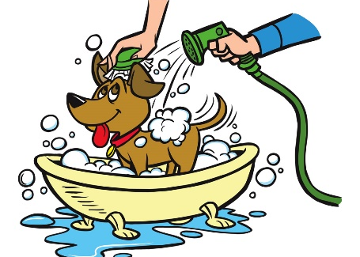
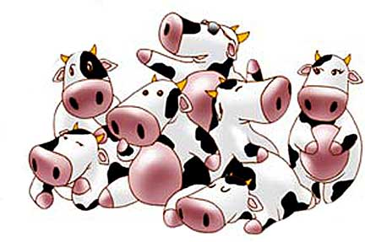
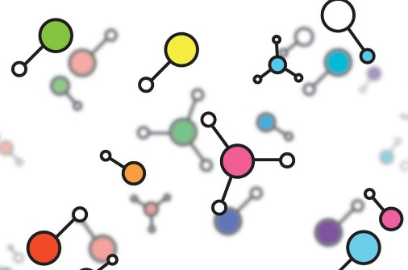

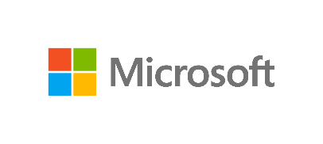
Cloud is a key enabler of DevOps – Agile & Functional a new way to think about a datacenter
I AM SPECIAL
WE ALL LOOK ALIKE
VIRTUAL
MACHINES
VM SCALE SETS
CONTAINER SERVICE
SERVICE FABRIC
Build on
Infrastructure Mindset
Build on
Platform Mindset
Ultimate Control
Traditional Model Cloud Model
Cost and Agility
System
Admin
Windows and Linux
.NET, Java, Python, PHP, Ruby, GO, Node.JS
Docker Swarm
Mesos, etc.,
Cloud Foundry,
Marathon, Deis, OpenShift etc.
Developer
Azure is Open at Every Layer
Notes:
Notes coming soon – please check back on http://aka.ms/opensource for latest version

Slide 28



How Containers Run
Hyper-V Containers
on VM
Windows Server Containers on VM
Docker Containers
Windows Server Containers
Azure Containers
ACS … Containers As A Service
Virtual Machines
Linux OR Windows
Hyper-V Containers
Hyper-V Hypervisor
Docker Engine
Container Service
Container Service
VM
Linux
OS
Hyper-V Hypervisor
Windows Containers can run on Windows 10 and Nano too!
Azure
Abstracts VM
Windows Host

Slide 29
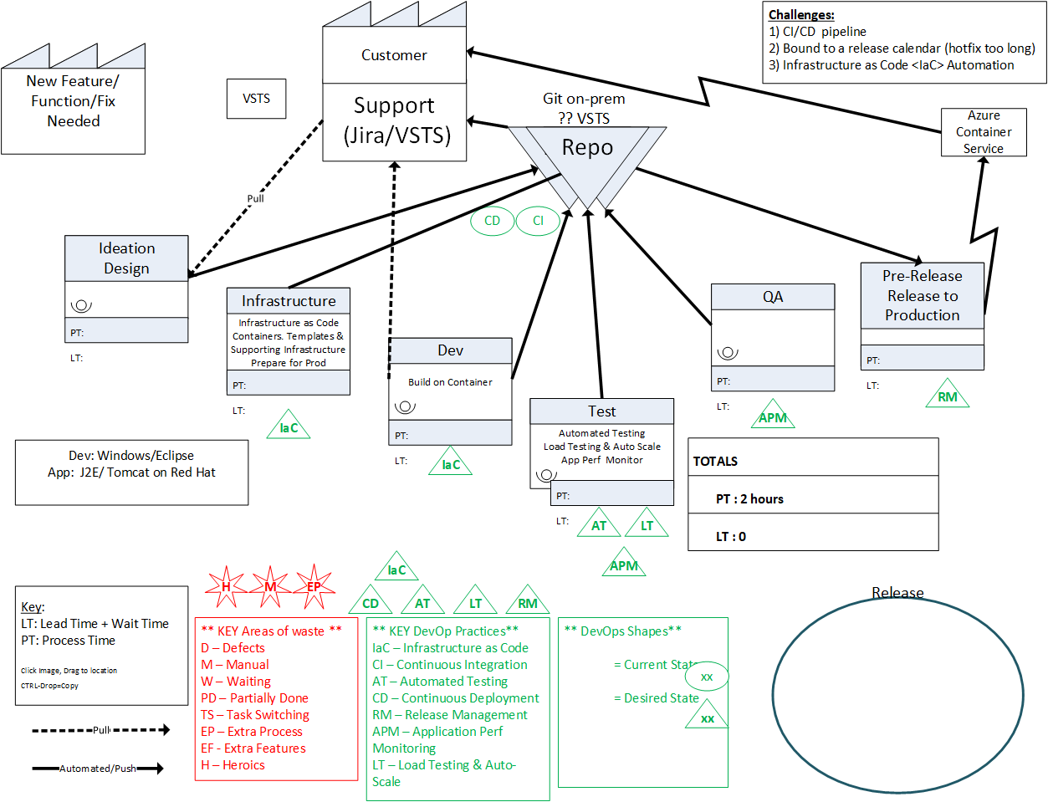
Value Stream Mapping – Understanding and Teaching

Slide 30
Microsoft Fortifies Commitment to Open Source, Becomes Linux Foundation Platinum Member
Why?
What does it mean? For Microsoft, for Linux, and most importantly to * Open Source * Now? Near future? Long term?
https://www.linuxfoundation.org/announcements/microsoft-fortifies-commitment-to-open-source-becomes-linux-foundation-platinum

Slide 31
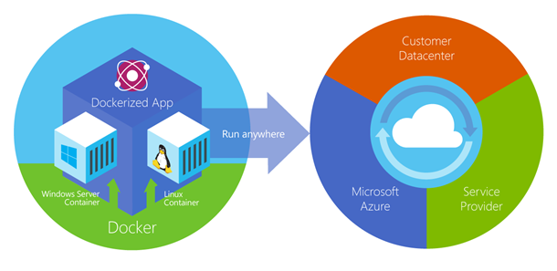
Docker and Container Portability
Notes:
Dockerized Apps are fully portable.

Slide 32
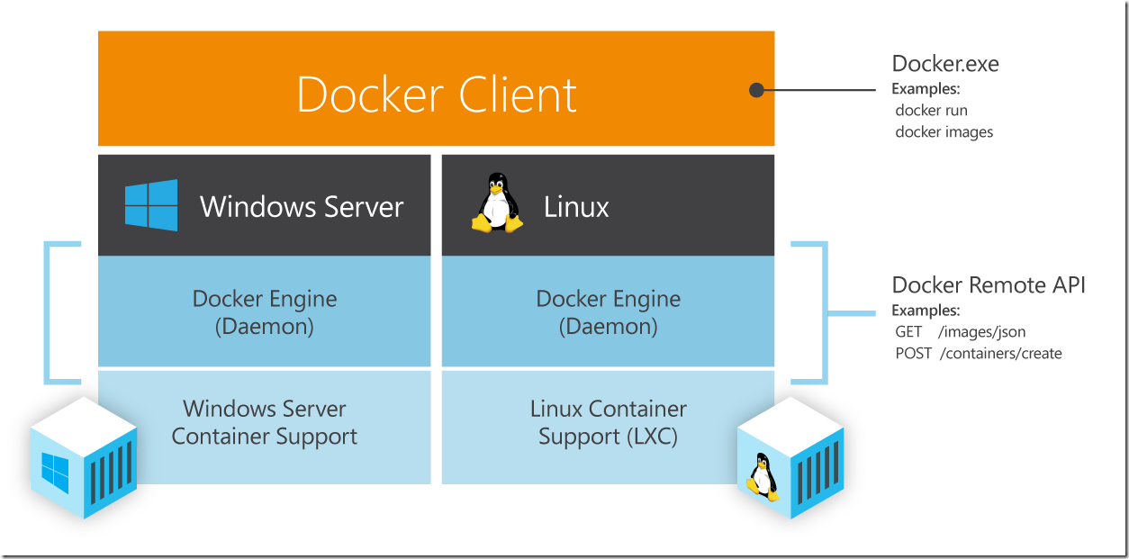
Docker Client runs the same on Windows and Linux

Slide 33
What is DevOps…
Infrastructure as Code (IaC)
Continuous Integration (CI)
Automated Testing
Application Performance Monitoring/Management (APM)
Continuous Deployment (CD)
Release Management
Configuration Management
DevOps Fundamentals
Advanced Monitoring
Capacity Management
Feature Flags
Self-Service Environments
Automated Recovery (Rollback & Roll-Forward)
Hypothesis Driven Development
Testing in Production – partial user base
Fault Injection
Usage Monitoring/Telemetry
A/B Testing (aka canary testing)
Gene Kim’s “3 ways”
The First Way emphasizes the performance of the entire system, as opposed to the performance of a specific silo of work or department — this as can be as large a division (e.g., Development or IT Operations) or as small as an individual contributor (e.g., a developer, system administrator).
The Second Way is about creating the right to left feedback loops. The goal of almost any process improvement initiative is to shorten and amplify feedback loops so necessary corrections can be continually made
The Third Way is about creating a culture that fosters two things: continual experimentation, taking risks and learning from failure; and understanding that repetition and practice is the prerequisite to mastery.
http://www.itproguy.com/devops-practices/
http://itrevolution.com/the-three-ways-principles-underpinning-devops/

Slide 34
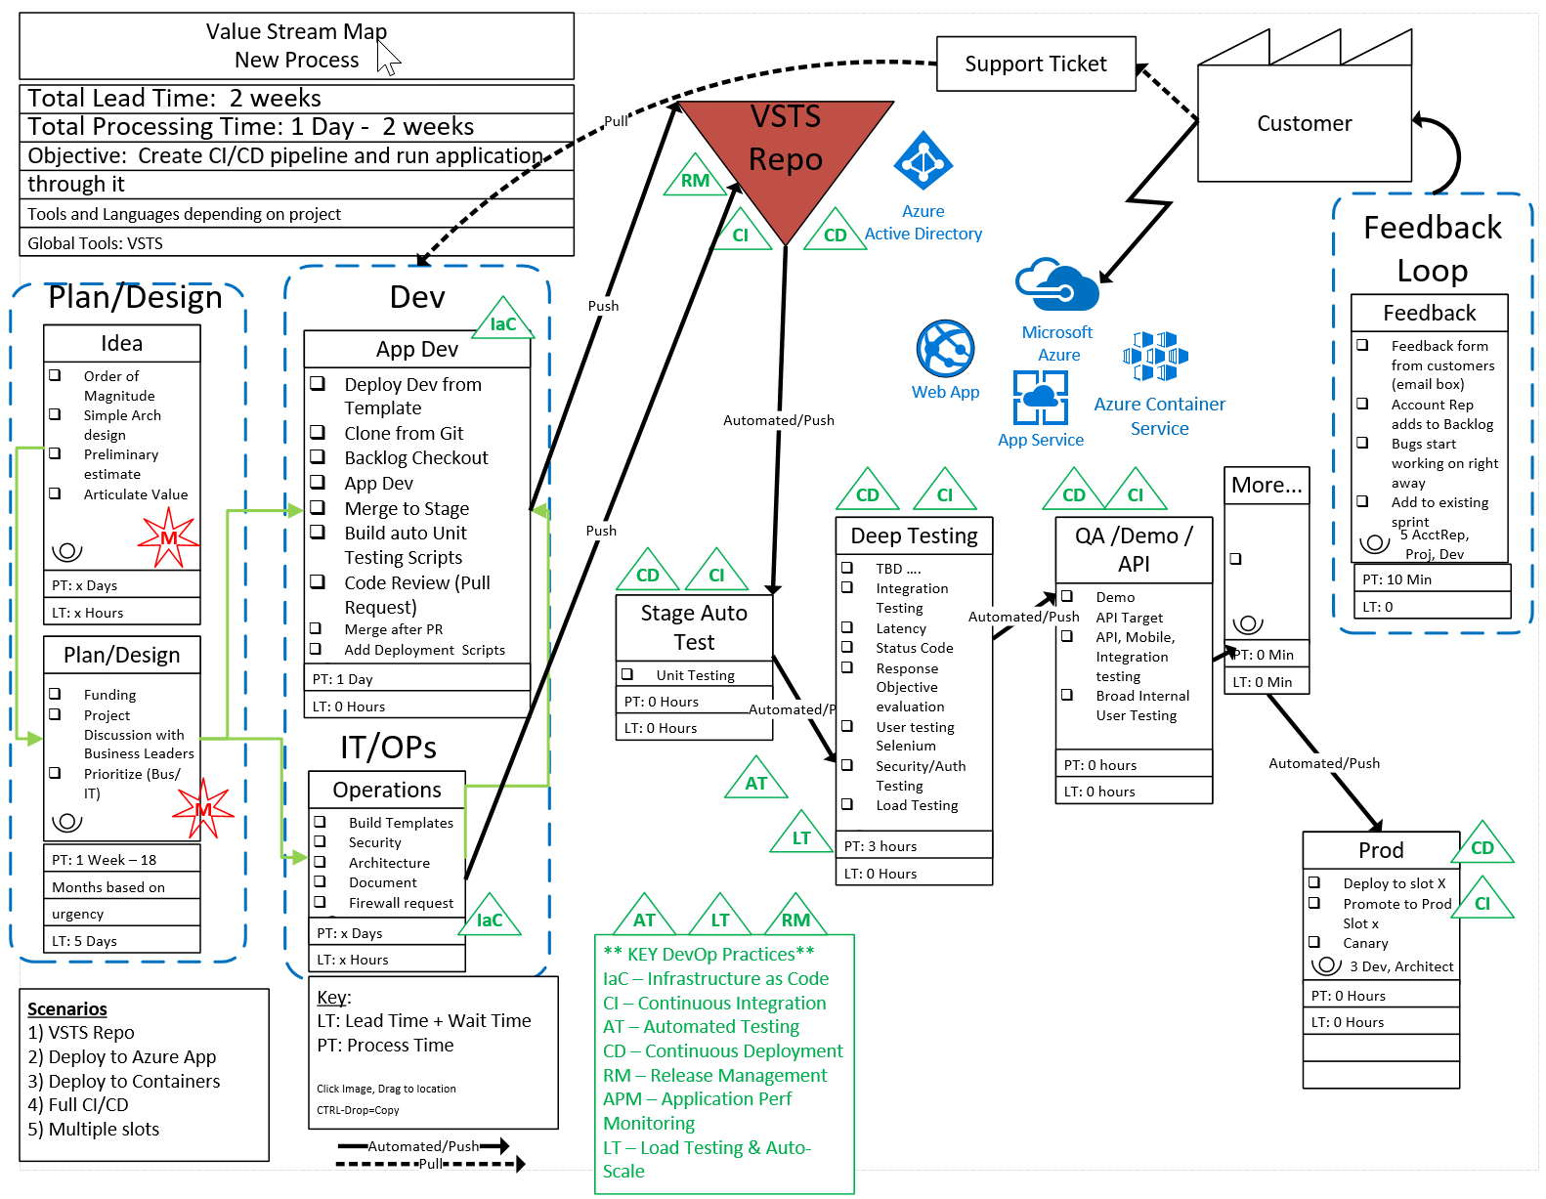
After DevOps
2 Week Lead time
1 Day – 2 Weeks processing time
Not all waste was cut in first pass
Fully automated and streamlined process with an application flowing through the system.
Investment: 3 weeks

Slide 35
Microservices

Slide 36
Monolithic vs Micro Services DevOps an Enabler of Micro Services
Micro Services
Split Services into small pieces
Easily Scale, Deploy, code, etc.
Faster Execution
Higher Reliability
Faster MTTR mean time to repair
Agile capabilities
Automation Continuous Delivery
Amplify Feedback Loops
Monolithic
All Feature in Full App
Long Cycles (Dev, Test, Q/A, Deploy, update, etc.)
Error / Bug Prone
Expensive
Quick Fixes hard or impossible
More bottlenecks
Harder to test (more changes at once)
Application
Feature A
Feature C
Feature E
Feature B
Feature D

Slide 37
Monolith and Microservices
Evolution of an application
Application
Application
Feature
A
Feature
B
Feature
C
Feature
A
Feature
B
Feature
C
Refactor
Update frequency
Different scale reqs
Different technology
Size, etc.

Slide 38
DevOps & Monolithic vs Micro Services
Micro Services
Split Services into small pieces
Easily Scale, Deploy, code, etc.
Faster Execution
Higher Reliability
Faster MTTR mean time to repair
Agile capabilities
Automation Continuous Delivery
Amplify Feedback Loops
Monolithic
All Feature in Full App
Long Cycles (Dev, Test, Q/A, Deploy, update, etc.)
Error / Bug Prone
Expensive
Quick Fixes hard or impossible
More bottlenecks
Harder to test (more changes at once)
Application
Feature A
Feature C
Feature E
Feature B
Feature D

Slide 39
What’s the downside?
More services means more network communication
Decreases overall performance due to network hops & (de)serialization
Requires more failure (timeout) recovery code
Hard to test in isolation without dependent services
Hard to debug/monitor across services
New service versions must support old & new API contracts simultaneously because client services don’t upgrade at the same time
DevOps persona trade short-term pain for long-term gain

Slide 40
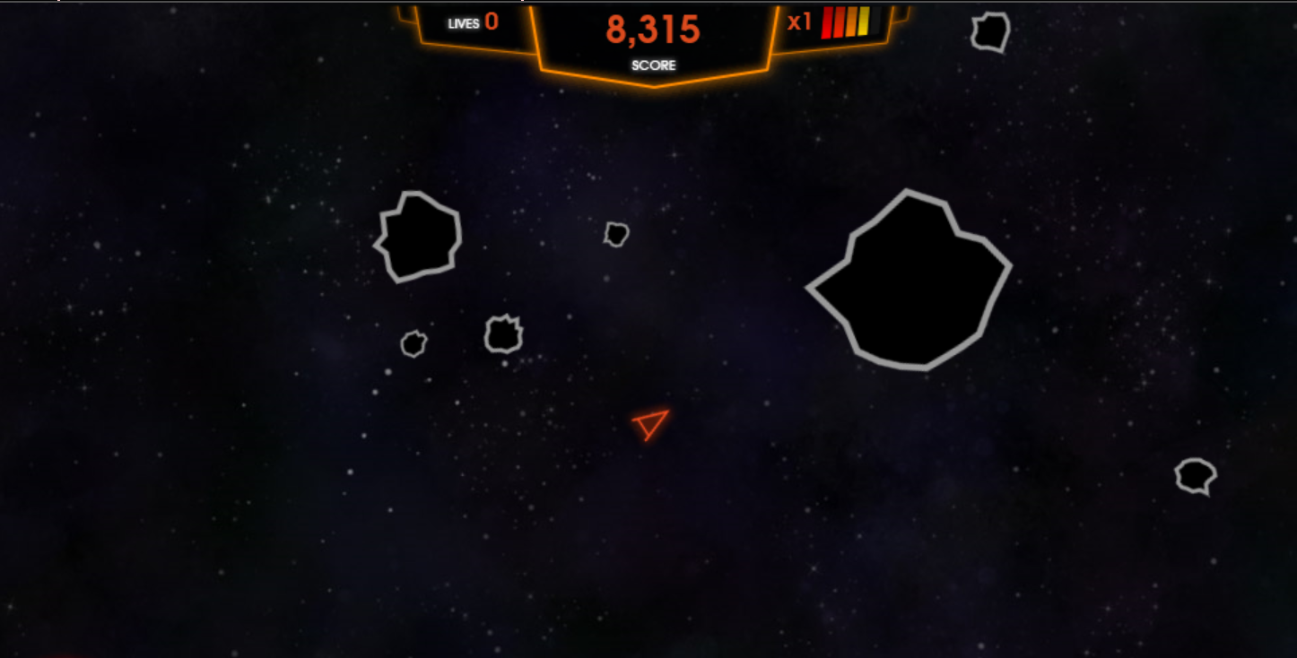
Monolith/Traditional vs Microservices/born in cloud
Asteroids

Slide 41
Azure Functions
Serverless compute
Azure Functions is an event driven, compute-on-demand experience that extends the existing Azure application platform with capabilities to implement code triggered by events occurring in virtually any Azure or 3rd party service as well as on-premises systems.
GitHub - Azure/Azure-Functions
github.com/Azure/Azure-Functions

Slide 42
Azure Functions Case Study
https://github.com/dstolts/AzureVDI

Slide 43
Security
Azure-The Most Secure and Trusted Cloud

Slide 44
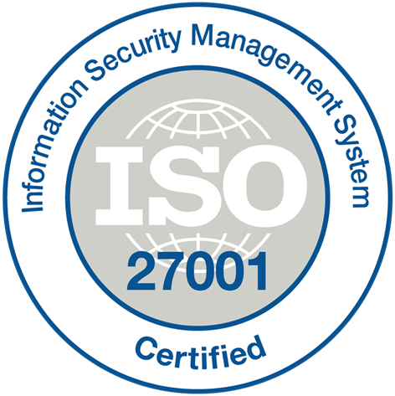
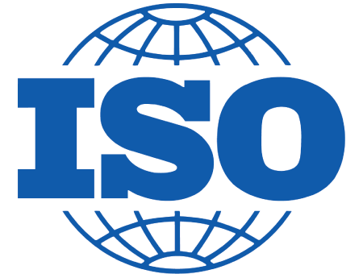
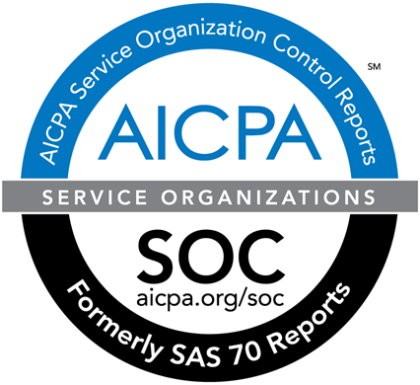
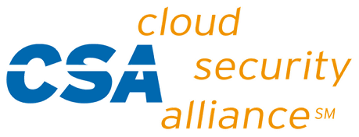
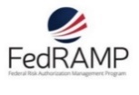

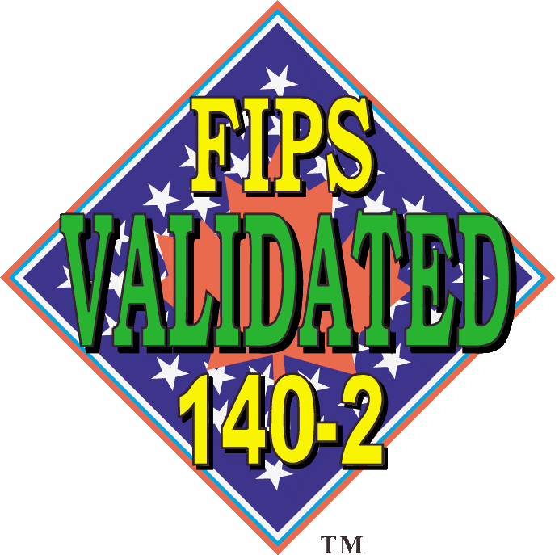





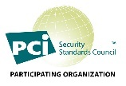
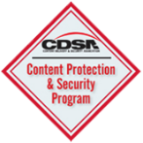
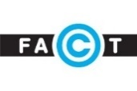


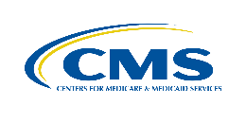










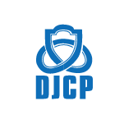

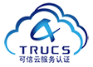


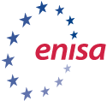










THE TRUSTED CLOUD
July 2017
Azure has the deepest and most comprehensive compliance coverage in the industry
GLOBAL
ISO 27017
ISO 22301
ISO 9001
SOC 1
Type 2
SOC 2
Type 2
SOC 3
CSA STAR
Self-Assessment
CSA STAR
Certification
CSA STAR
Attestation
ISO 27001
ISO 27018
US GOV
Moderate
JAB P-ATO
High
JAB P-ATO
DoD DISA
SRG Level 2
DoD DISA
SRG Level 4
DoD DISA
SRG Level 5
SP 800-171
FIPS 140-2
Section 508 VPAT
ITAR
CJIS
IRS 1075
INDUSTRY
PCI DSS
Level 1
CDSA
MPAA
FACT UK
Shared
Assessments
FISC Japan
HIPAA / HITECH Act
HITRUST
GxP
21 CFR Part 11
MARS-E
IG Toolkit UK
FERPA
GLBA
FFIEC
REGIONAL
Argentina PDPA
EU
Model Clauses
UK
G-Cloud
China
DJCP
China
GB 18030
China
TRUCS
Singapore
MTCS
Australia
IRAP/CCSL
New Zealand
GCIO
Japan My
Number Act
ENISA
IAF
Japan CS Mark Gold
Spain
ENS
Spain
DPA
India
MeitY
Canada
Privacy Laws
Privacy
Shield
Germany IT
Grundschutz
workbook
Notes:
Feb-2017: Azure compliance coverage includes 54 offerings.

Slide 45
Sample microservices application dev-ops flow using containers
Docker registry
flakio/s1
S1-Dev
S1-QA
S1-Prod
flakio/s2
S2-Dev
S2-QA
S2-Prod
Key points:
Each service has its own repo
Each service has its own CI/CD pipeline
Staged environments can be used but don’t have to (Testing in production)
flakio/s3
S3-Dev
S3-QA
S3-Prod
Dev Cluster
QA Cluster
Prod Cluster
Notes:
CI/CD = Continuous Integration/Continuous Deployment

Slide 46





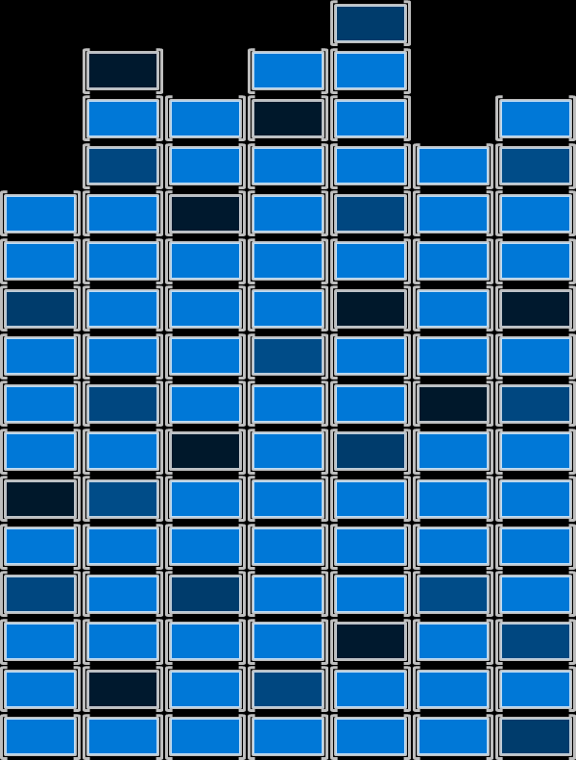
Dev/Ops Process with Containers
Developers update, iterate, and deploy updated containers
2
3
Operations collaborates with developers to provide app metrics and insights
Developers build and test apps in containers, using development environment i.e. Visual Studio
Operations automates deployment and monitors deployed apps from central repository
1
Central Repository
2
Containers pushed to central repository

Slide 47
Higher Level Services
User workload or service
Get and manage VM’s
Install task applications
Significant amount of infrastructure, not related to business
Manage and authenticate users
Start the tasks
Move task input and output
Queue tasks
IaaS or Cloud Service
Standard or custom images
Windows or Linux
Task failure? Task frozen?
Scale up and down
Cloud Services
IaaS
Virtual Machines
Commodity to high-performance
Small to huge
RDMA network for tightly coupled tasks
Hardware

Slide 48


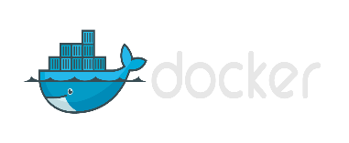



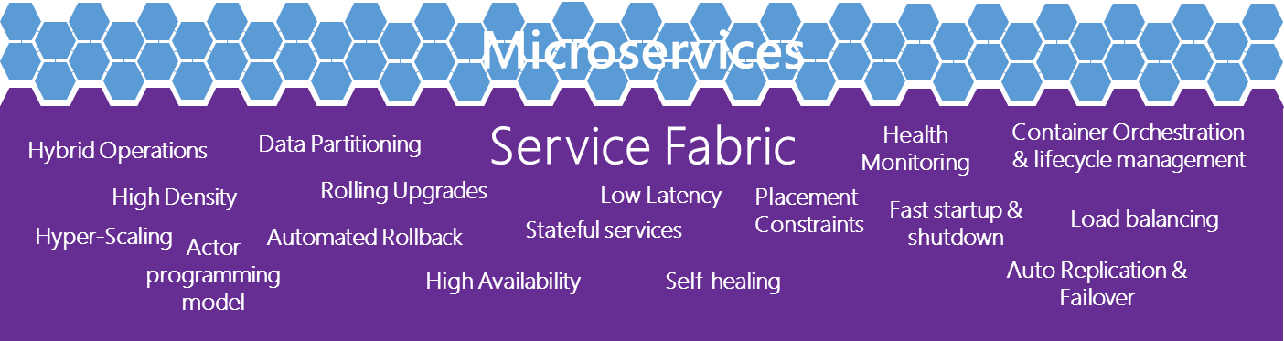
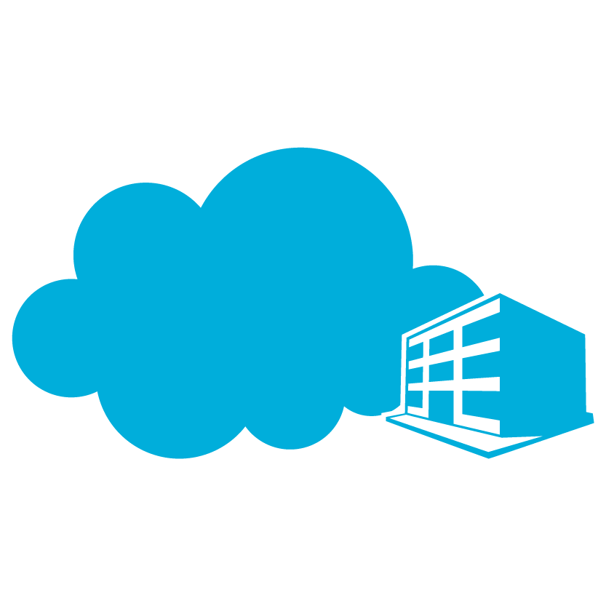

The right tools
Container Management
PowerShell
Docker
Others
Development Environments
Development Frameworks
and Languages
Virtual Machines / Container Technologies
Go
Perl
Linux
PHP
Phython
Node
JavaScript
.Net
C++
Ruby
Win32
Java
Others…
Service Fabric
Microsoft Cloud
Azure
On Premises
Service Provider

Slide 49

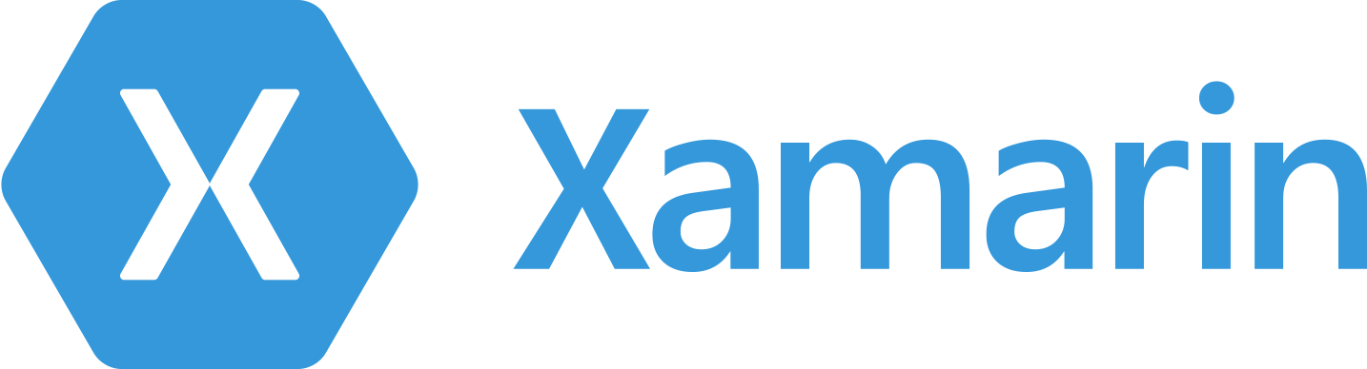
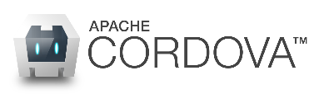
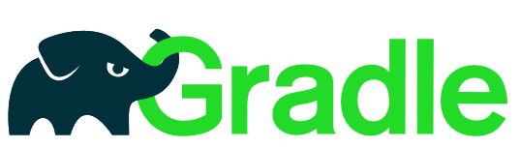

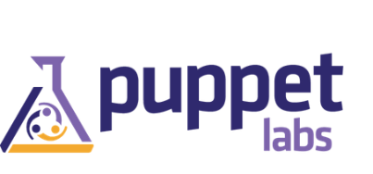

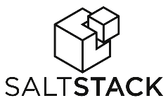







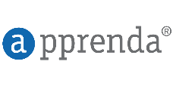
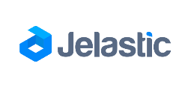
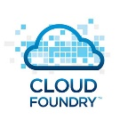
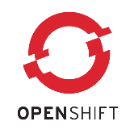
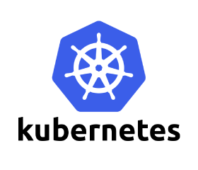
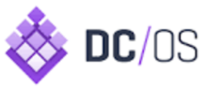
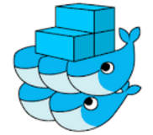

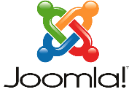


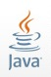




















Azure is an open cloud
DevOps
Clients
Management
Applications
Orchestration
PaaS
App Frameworks
& Tools
Databases &
Middleware
Infrastructure

Slide 50
How Long Will it take to be mainstream?
Micro Services
3-5 Years
Many are now leveraging the processes
It will take time for applications to be rewritten using new technology
DevOps practices will dictate
As people learn about the massive capabilities of Agile, DevOps capabilities they will institute these changes but it will take time to change many apps
Cloud scale and cost savings could make it shorter (possibly much shorter)
Containers
Now
Docker has already started driving this technology forward
Usually no “coding” changes are needed so very fast adoption
Docker, Cloud providers and new Server OS are all making it easy and cost effective

Slide 51
Homework [Optional]
Create Docker Account and link it with Azure
https://beta.docker.com/docs/
Create Wordpress Site on Azure in a Docker Container; login to wordpress to do preliminary setup (admin credentials)
Install Docker for Windows on your local machine
https://docs.docker.com/engine/installation/windows/
Agenda 8/30
Review Homework (if desired)
Q&A
Next Steps

Slide 52
Containers Offer
Fast Iteration
Resource Controls
Rapid Deployment
Defined State Separation
Immutability
(unchangeable)

Slide 53
Making Them Ideal For
Distributed Compute
Databases
Web
$$f\left(x\right)$$
Scale Out
Tasks

Slide 54

Azure Container Service Template
orchestratorProfile
masterProfile
agentPoolProfiles
linuxProfile

Slide 55
Learn more with FREE IT Pro Resources
Free technical training resources:
On-demand online training: http://aka.ms/moderninfrastructure
Free ebooks:
Deploying Hyper-V with Software-Defined Storage & Networking: http://aka.ms/deployinghyperv
Microsoft System Center: Integrated Cloud Platform: http://aka.ms/cloud-platform-ebook
Expand your Modern Infrastructure Knowledge
Get hands-on: Free virtual labs:
Microsoft Virtualization with Windows Server and System Center: http://aka.ms/virtualization-lab
Windows Azure Pack: Install and Configure: http://aka.ms/wap-lab
Join the IT Pro community:
Twitter @MS_ITPro

Slide 56
Free Resources for DevOps Practices
Optimize your DevOps practices & tools:
Get started on your DevOps journey: aka.ms/devops
Download the Forrester Infrastructure-as-Code whitepaper:
Complexity kills. Automate with Infra as code: aka.ms/iac_tlp
Accelerate your application delivery lifecycle
Technical resources for Practitioners:
Get access to free online training, evals and HOLs: aka.ms/devopsmva
Join the Community conversations:
Use #TalkDevOps on Twitter

Slide 57
Event Notifications – Http://ITProGuru.com/join Example: Azure Certification Jump Start 70-534 Architecting Microsoft Azure Solutions
Brought to you By:
@ITProGuru
Microsoft
#1 Design Azure Resource Manager (ARM) networking (5–10%)
Design Azure virtual networks - Extend on-premises
Describe Azure VPN and Express Route architecture and design
#2 Secure resources (20–25%)
Secure resources by using managed identities
Secure resources by using managed identities
Secure resources by using identity providers
Identify an appropriate data security solution
Design a role-based access control (RBAC) strategy
Manage security risks by using an appropriate security solution
#3 Design an application storage and data access strategy (5–10%)
Design data storage
Select the appropriate storage option
#4 Design advanced applications (20–25%)
Create compute-intensive applications
Create long-running applications
Integrate Azure services in a solution
Implement messaging applications
Implement applications for background processing
Design connectivity for hybrid applications
#5 Design Azure Web and Mobile Apps (5–10%)
Design Web Applications
Design Mobile Applications
#6 Design a management, monitoring, and business continuity strategy (20–25%)
Design a monitoring strategy
Describe Azure business continuity/disaster recovery (BC/DR) capabilities
Design a disaster recovery strategy
Design Azure Automation and PowerShell workflows
Describe the use cases for Azure Automation configuration
#7 Architect an Azure Compute infrastructure (10–15%)
Design ARM Virtual Machines (VMs)
Design ARM template deployment
Design for availability
+ Bonus: Containers
Join EVENTS Mailing List NOW!
http://www.amazon.com/dp/0735697442/ref=rdr_ext_tmb
Other Event Plans:
DevOps, Containers,
Application Pipeline,
MicroServices & More
ITProGuru.com/Join
Curriculum for Attendees
Notes:
http://aka.ms/70-534 – Once it goes live..
Learn what you need to know to become a certified Azure Solutions Architect. We will go through the lessons found in the book 70-534 Architecting Microsoft Azure Solutions. We will wrap things up with our speakers (and authors of the book) doing a book signing so bring your copy of the book.
70-534 Introduction
Exam Tips and Tricks
Design an advanced application (15–20%)
Design websites (15–20%)
Design a management, monitoring, and business continuity strategy (15–20%)
Design Microsoft Azure infrastructure and networking (15–20%)
Secure resources (15–20%)
Design an application storage and data access strategy (15–20%)
Field Experiences
Book Signing – Authors Dan Stolts, Steve Maier

Slide 58
What’s Next?
How can you stay up to date?
Follow me on Twitter @ITProGuru
Follow my Blog http://ITProGuru.com
http://ITProGuru.com/Join
Ben Day: DevOps with VS https://www.benday.com/2016/09/20/new-pluralsight-course-devops-skills-with-visual-studio-tfs/
Windows Container’s site https://msdn.microsoft.com/virtualization/windowscontainers
http://aka.ms/windowscontainers

